Slide 1
TCS Quantum Challenge
Final Defence Presentation
Challenge 3- Optimizing Fleet Allocation
Team Lead Name : Gajendra Malviya​​
Team Member Name : Aakash Swami
Team Entry Number : 03360112

Slide 2
Executive Summary
Problem Statement
Given a set of flights with timings, allocate named aircrafts of right capacity to cover the flights
Minimize operating cost and maximize aircraft utilization, meet all operational and maintenance constraints
Approach
Hybrid (Classical + Quantum) approach using Quantum Alternating Operator Ansatz (QAOA)
Heuristically generate a feasible allocation and optimize using QAOA with mixers
Compare with Binary Integer Program (BIP) model for quality and time advantage
Ran on local MPS simulator for 20 shots, actual QPU not used
Results
Allocated 1460 fights (81.4 %) with no delay for all allocated flights
Classical and Quantum gives same #allocated flights, #empty flights, aircraft cost but classical have lower seat deficits
On local simulator no time advantage seen for quantum, results of AWS is awaited

Slide 3
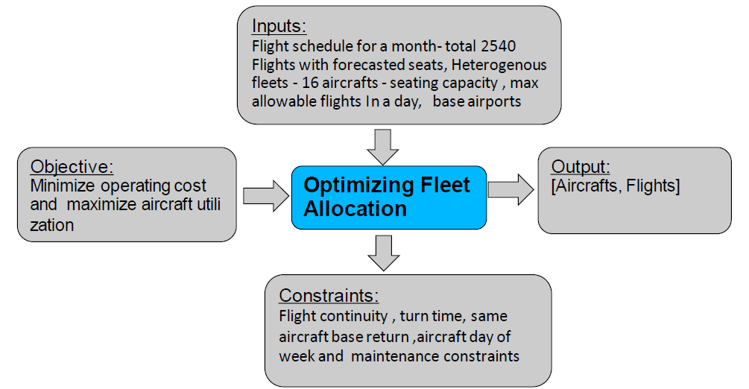
Challenge Statement
Notes:
Check 123

Slide 4
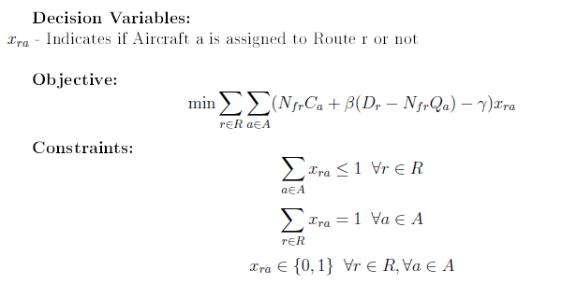
Solution Approach
Hybrid (Classical + Quantum) approach is implemented, algorithm Quantum Alternating Operator Ansatz (QAOA) is used
Classically data will be preprocessed to get feasible allocation and it will be optimized using QAOA with mixers
Data Preprocessing : data correction, made routes from the given flight legs by combining sequential flights (legs)
Done route assignment to aircraft, later postprocessed routes to get flights
Filter on both the factors, aircrafts max allowable flights and base airports - LGW, LTN, MAN to reduce decision variables
To compare with internal benchmark, classically BIP model is used
We have solved for each date, for full data of 28 days,
and accumulate results for full data
Number of Flights in Routes | Aircraft Max Allowable flights
3 | 3
4 | 4, 5
6 | 6, 7

Slide 5
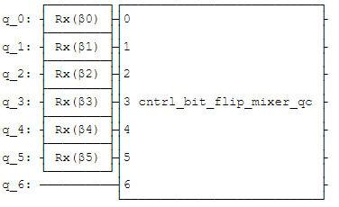
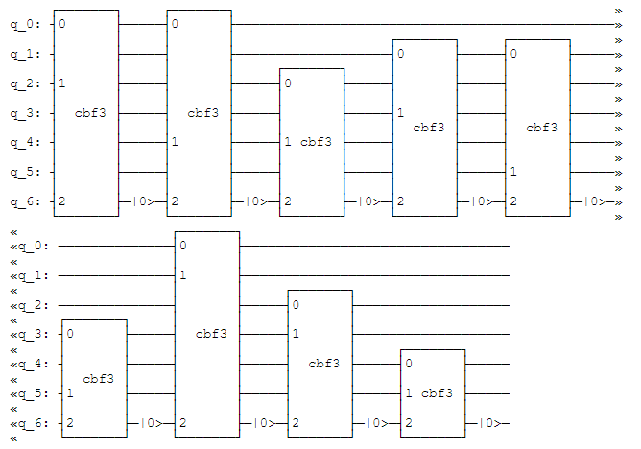
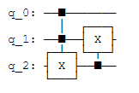
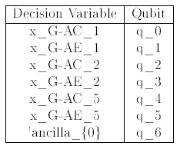
QAOA Approach
QAOA with mixers is used, Controlled Bit-flip mixer used for constraint feasibility
Decision variables of BIP model as qubits in QAOA i.e. all feasible combinations as qubits
Qubit is a decision variable indicates aircraft allocated to route
The constraints have been incorporated as mixers, In Controlled Bit-flip mixer,
we used CNOT gates, to avoid infeasible state (infeasible allocation)
Modeled QAOA objective as aircraft cost and difference in forecasted seats and
aircraft capacity with weightage, same as in BIP model
QAOA Ansatz, Mixer circuits, Controlled Bit-flip mixer for
List Aircrafts = ['G-AC', 'G-AE'] , List Routes = [1, 2, 5] are shown here
Constraints fulfilment by data preprocessing and mixers circuit

Slide 6
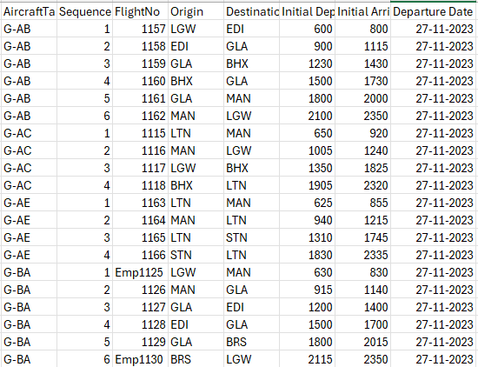
Results
Results for 20 shots, 1 layer, by local simulator, MPS (' Matrix Product State’) and COBYLA optimizer in QAOA,
β = 100, γ = 100000
Evaluation Metrics : Aircraft cost and utilization, demand fulfilment
Quantum Results for full given data :
Number of Allocated Flights : 1460
Number of Empty Flights : 162
Aircraft Cost : 10274000
Deficit in Seats : 9691
Classical Results for full given data:
Number of Allocated Flights, Number of Empty Flights, Aircraft Cost in Classical is same as that of quantum results,
Deficit in Seats : 8681
We get less Deficit in seats in classical compared to quantum, Quantum does not perform better in Deficit of seats metric compared to Classical
Able to assign 1460 (81.4 %) out of 2540 flights for full data, inserted 162 empty Flights, from and to the Base airport at Start and End of some routes to full base airport constraint
After aircraft day of week and maintenance constraint, the maximum number of flights we can assign for full data are 1794
Able to assign 1622 (1460+162) flights out of possible 1794 flights allocations

Slide 7
Way forward for our approach
Model delaying of flights
As the problem size increases (number of flights and available aircrafts increases), decision variables increases (as number of possible feasible allocation increases), more qubits will be required for our approach
We can run our solution approach on actual QPU with more number of qubits, we don’t have to get feasible allocations options also, we can solve the whole problem at one go for a day and combine results for full data

Slide 8
Business Impact from Quantum
We do not get any advantage in solution quality or execution time in solving this problem in Quantum (local MPS simulator) compared to Classical
Solution quality or execution time advantage for complex and large data size may be observed in implementation of the Connection network model [1] in Quantum

Slide 9
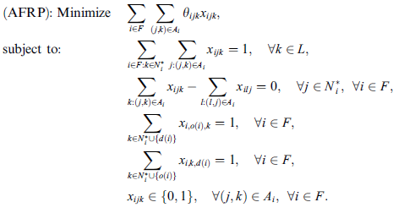
Appendix
Connection network model –
[1] Haouari, Mohamed et al. "Network flow-based approaches for integrated aircraft fleeting and routing". Eur. J.Oper. Res. 193 (2009):591-599

